Slide 1
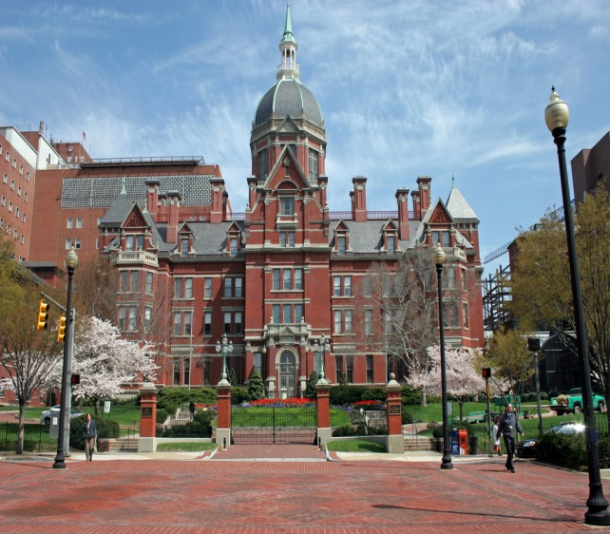
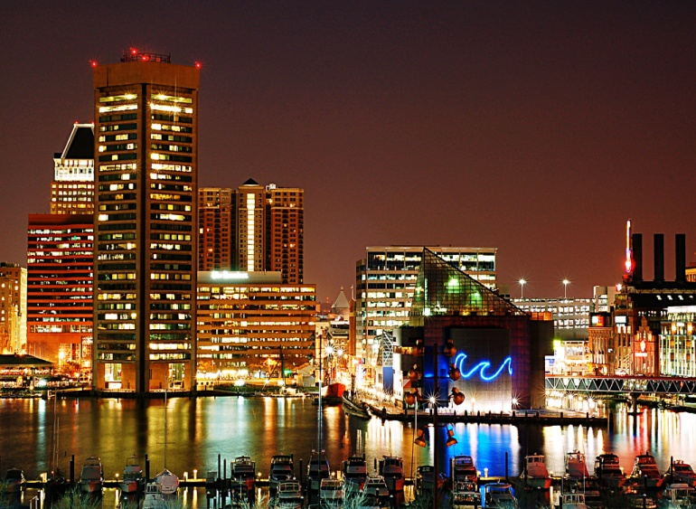

Baltimore, Maryland
Home of The Johns Hopkins Hospital, and The Johns Hopkins School of Medicine, founding institutions of modern American medicine
Home of The Inner Harbor - historic seaport, tourist attraction and iconic landmark
Home of The Baltimore Ravens with 7 playoff appearances since 2000

Slide 2
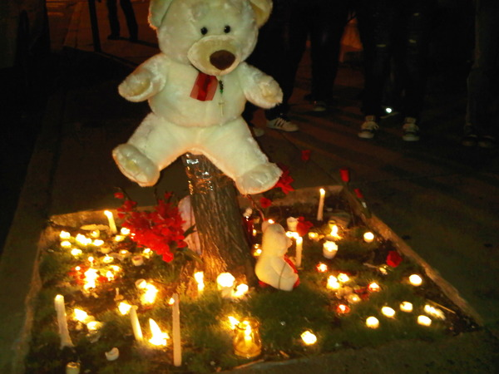
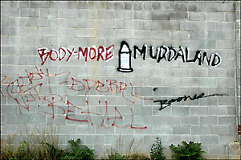
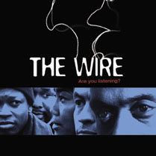
Baltimore, Maryland
Where the leading cause of death among Baltimore City residents aged 15-24 years is homicide
Where 30% of children grow up in poverty
Where many youth don’t believe they’ll live to be 25, and if they do for some it will be behind bars
Where the juvenile homicide rate is 8.4 times higher than the national rate

Slide 3
Baltimore City Homicides

Slide 4
Baltimore City Non-Fatal Shootings

Slide 5

Violence as a Public Health Issue
Health problem (disease)
Epidemic
Infectious
Based in behavior (learned/social norm)
Behavioral interventions can interrupt transmission by changing norms

Slide 6
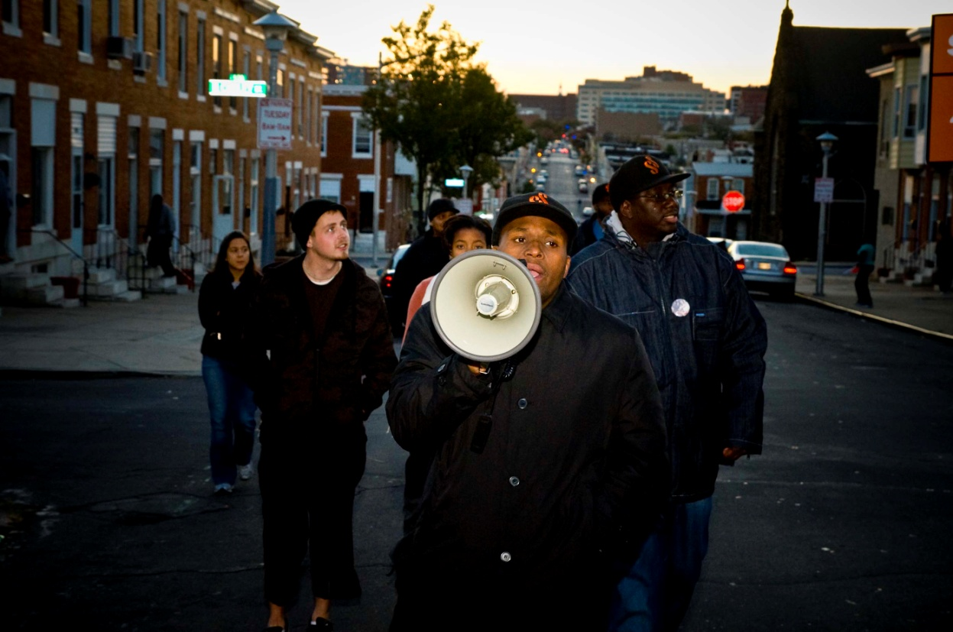
Core Components
Community Mobilization
Outreach
Public Education
Faith-based Leader Involvement
Criminal Justice Participation

Slide 7
Implementing Behavior Change Theory
Interveners
3 Variables
Behavioral Outcome
Street
Outreach
Clergy
Community
Pub Ed
Materials
Law Enforcement
Norms
No
Shootings
Risk
Alternatives

Slide 8
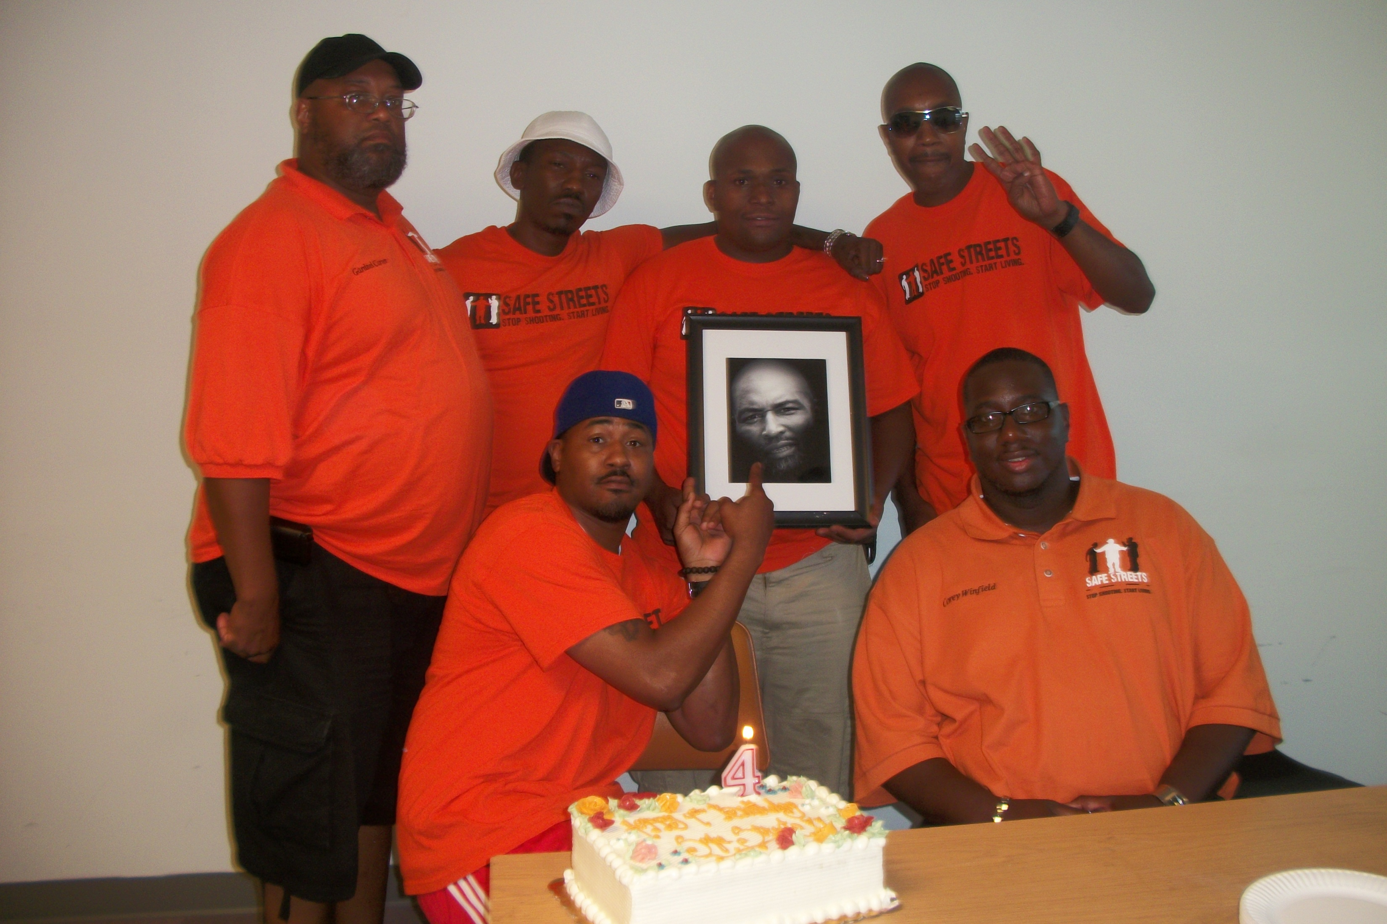
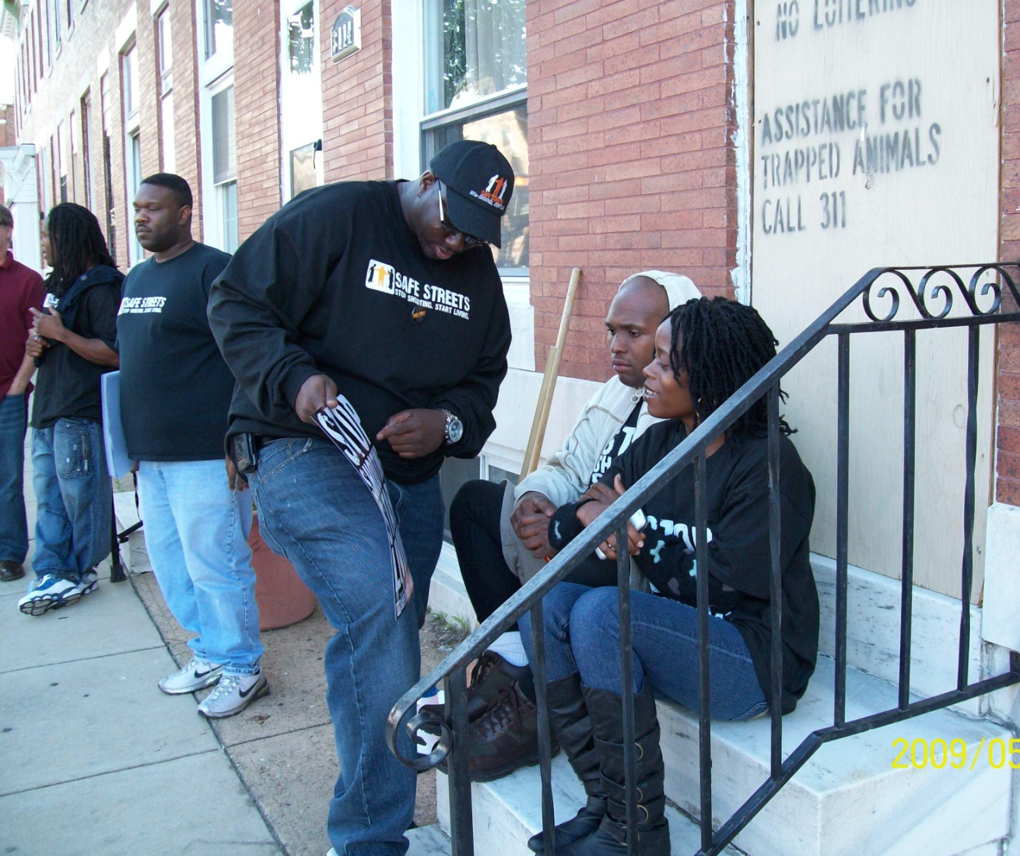
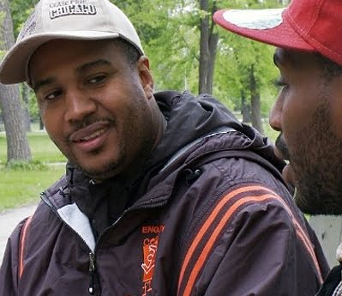
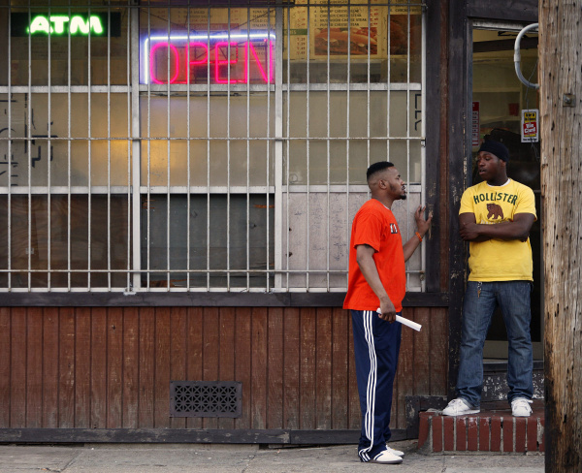
Differences between CeaseFire & Safe Streets
CeaseFire
Safe Streets
Violence Interrupters
National Gangs
Outreach Workers
Neighborhood Gangs

Slide 9
Role of the Oversight Entity (BCHD)
  Responsible for rigorous vendor and site selection process
  Provide implementation technical assistance to sites
  Intensive monitoring of community-based providers to ensure adherence to the Ceasefire model
  Creation of a citywide public education campaign
  Development of an expansion and sustainability plan for the Safe Streets initiative

Slide 10
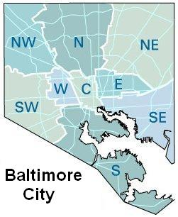
Selection Process
  Open Request for Proposals
  Fifteen (15) eligible Community Statistical Areas (CSAs)
  Ten (10) eligible neighborhoods outside the eligible CSAs
  Target areas should have populations between 10,000 and 20,0000 people

Slide 11

Applicants must:
Be designated as a 501(c)(3)
Currently operate in the target community and have an office in the target community
Selection Criteria includes:
Level of need in the selected target area
Demonstrated understanding of the Safe Streets model
Reputation and credibility of applicant in the target community
Experience providing community outreach services to target population

Slide 12

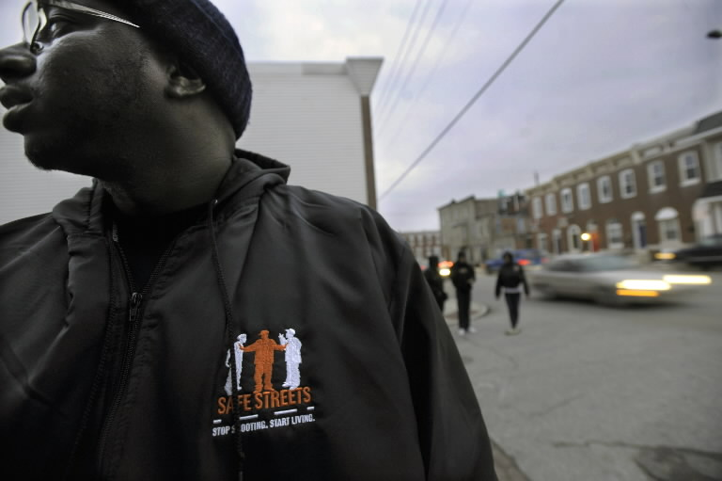
Safe Streets East – The Living Classrooms Foundation
McElderry Park
Main thoroughfare in East Baltimore
Outreach Workers = Violence Interrupters
Began working out of a car
Success based on hiring the “Right” workers
In the first 23 months of implementation there were ZERO homicides

Slide 13
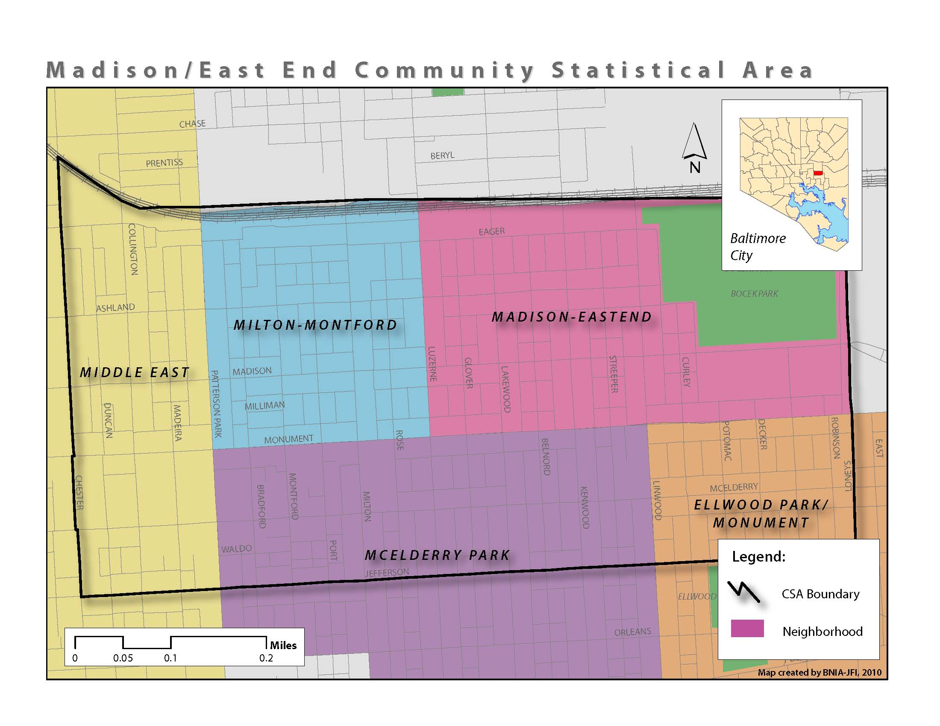

Slide 14
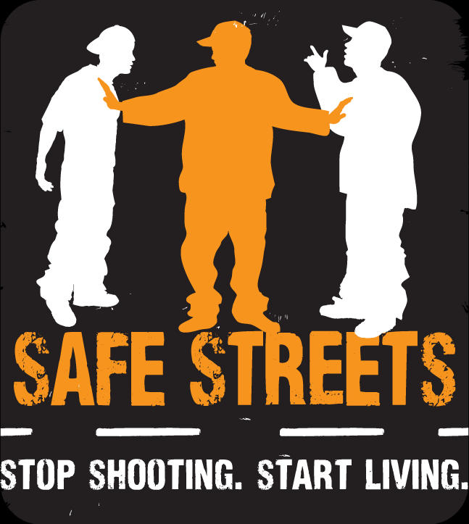
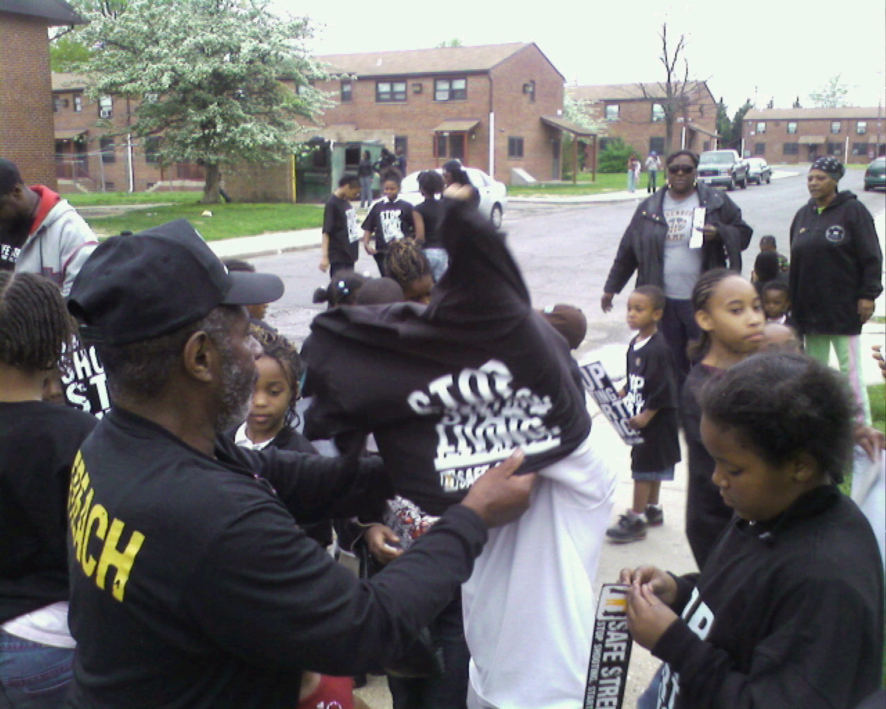
Safe Streets Cherry Hill –
Family Health Centers of Baltimore
Extremely isolated area
Historic gang feud
Success based on community partnerships
Evaluation results show a approximately 56% decrease in homicide incidents and 34% decrease in NFS

Slide 15
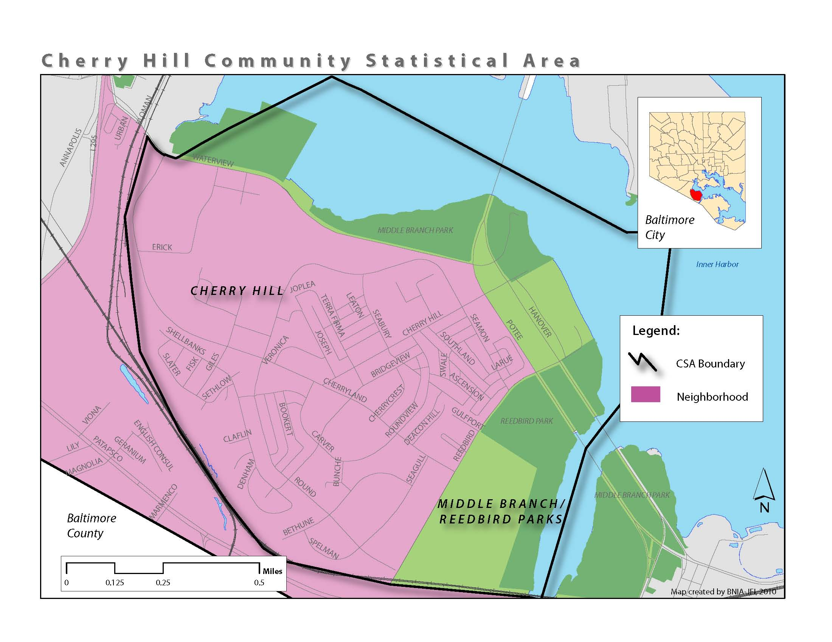

Slide 16
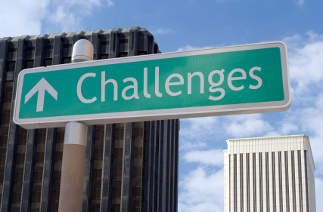
CHALLENGES OF IMPLEMENTATION

Slide 17
City Agency = Political Pressure
+
You don’t share information with the police?!?!

Slide 18
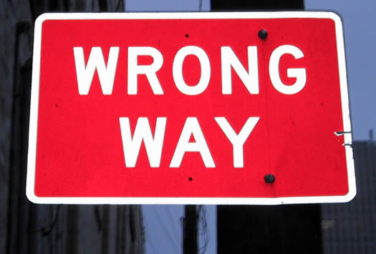
The WRONG community partner

Slide 19
3 contiguous sites – Don’t try at this at home

Slide 20


Slide 21
Evaluation Results
Key findings:
Safe Streets - Cherry Hill was associated with statistically significant reductions of 56% in homicide incidents and 34% in nonfatal shootings
Safe Streets - East did not experience a homicide during the first 23 months of program implementation. After pilot of three sites ended, in the initial post homicides were 53% lower than would have been expected without the intervention
Safe Streets - Cherry Hill was associated with statistically significant reductions of 56% in homicide incidents and 34% in nonfatal shootings
Safe Streets - East did not experience a homicide during the first 23 months of program implementation. After pilot of three sites ended, in the initial post homicides were 53% lower than would have been expected without the intervention

Slide 22
Key findings:
Across all sites and border posts - estimates show that the program was associated with 5.4 fewer homicide incidents and 34.6 fewer nonfatal shooting incidents during 112 cumulative months of intervention post observations
Outreach Workers assisted 52% of program participants settle an average of 2 disputes. 28% of these disputes involved guns and 91% avoided violence. Overall, 80% of participants reported that their lives were “better” since becoming a program participant

Slide 23
Analyses of program implementation data indicate that the sites with significant reductions in homicide incidents had three times as many conflict mediations per month.

Slide 24
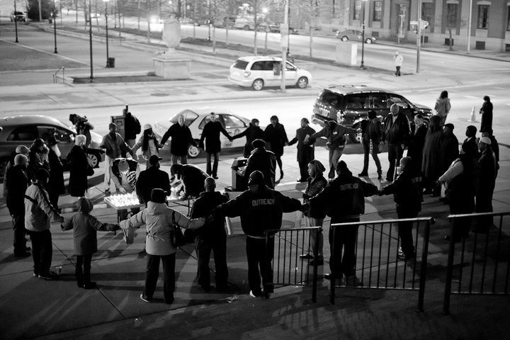
2010 Accomplishments

Slide 25


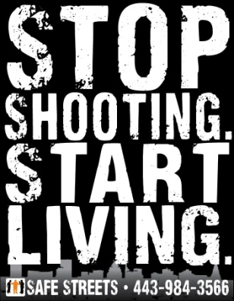
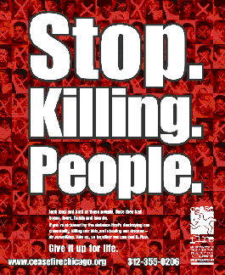
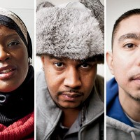
Next Steps for Safe Streets - Baltimore
Move longest-running site
Expand to 2 additional neighborhoods
Enhance the current Public Education campaign
Pilot Violence Interrupters
Seek Funding
Move Longest-running site
Expand to 2 additional neighborhoods
Enhance the current public education campaign
Pilot Violence Interrupters
Seek Funding

Slide 26
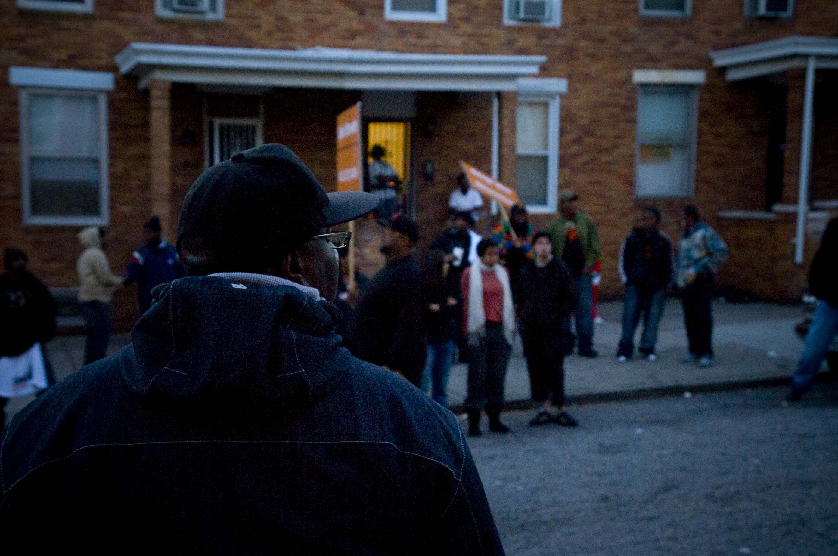
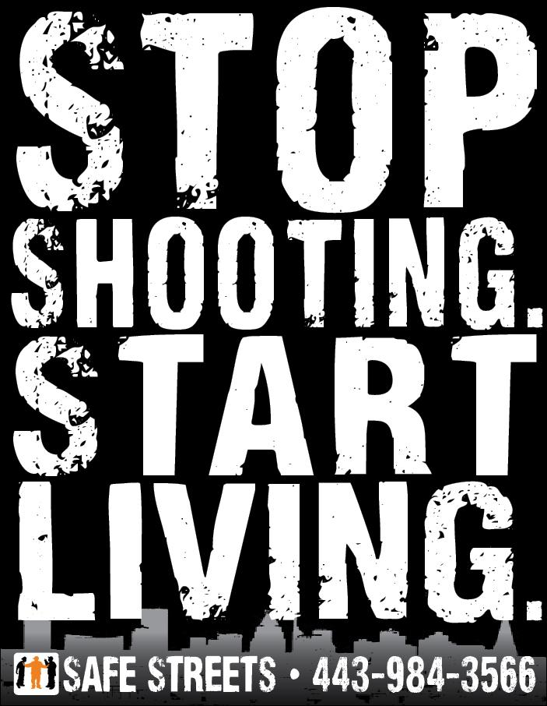


For Additional Information:
Lori Toscano, Acting Director
443.984.3566
Lori.Toscano@baltimorecity.gov
For Additional Information:
Lori Toscano, Acting Director
443.984.3566
Lori.Toscano@baltimorecity.gov
www.Facebook.com/BmoreYVP
www.Facebook.com/BmoreYVP

